Slide 1
Methods discussion

Slide 2
Questions
Are the methods comparable?
Which methods are we going to use to survey moving forward?

Slide 3
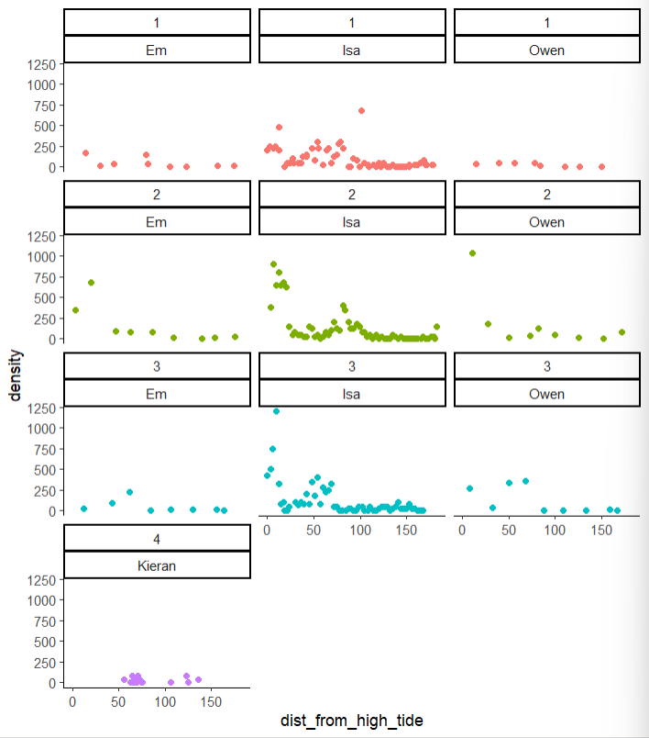

Slide 4
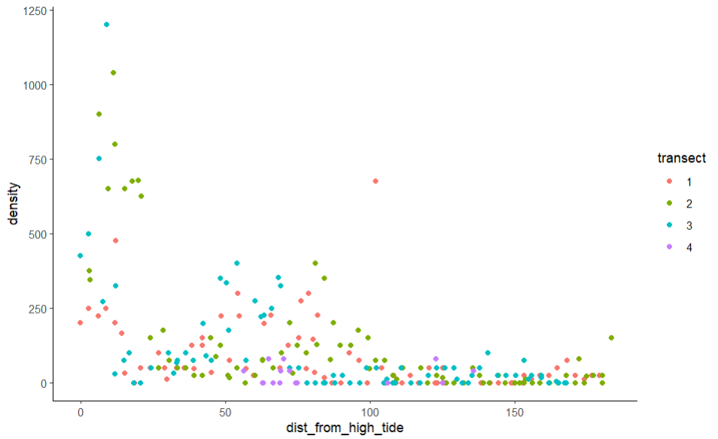

Slide 5
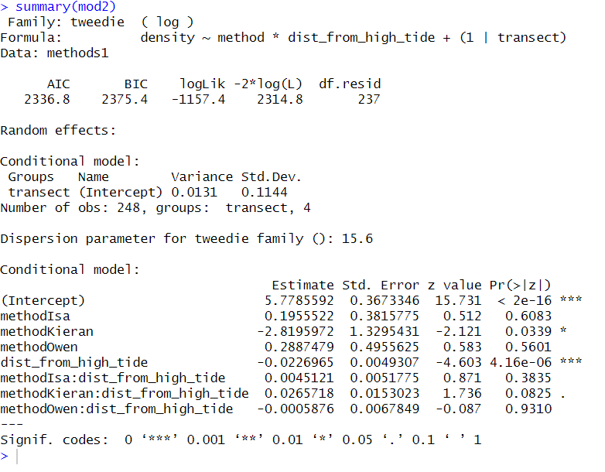
Notes:
Tweedie distribution with a log link: often used for count edata that has a lot of zeros
Response variable: density
Predictos: method (categorical), distance from high tide (numeric), method*distance from high tide (interactions between the terms)
Random effect of transect – points at a transect are more likely to be similar to eachother
Kieran’s produce a much lower density than the reference which is Em
Owen and Isa are not significantly different than Em
Distance from high tide is significant: density drops as you move from high tide line for reference (em)
Interactions are all not sifniciance but Kieran’s is weak evidence 0.0825

Slide 6
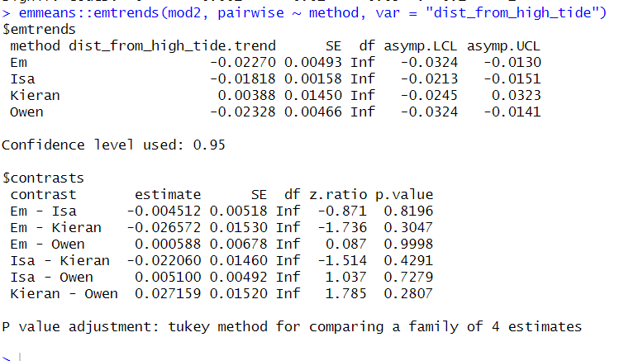
Notes:
Checking whether the relationship b etween distance and density changes depending on methods used
Em: -0.02270 – density decreases as distance increases
Isa: -0.018 – slight decrease weaker than Em’s
Kieran: 0.00388 – small increase but not significant

Slide 7
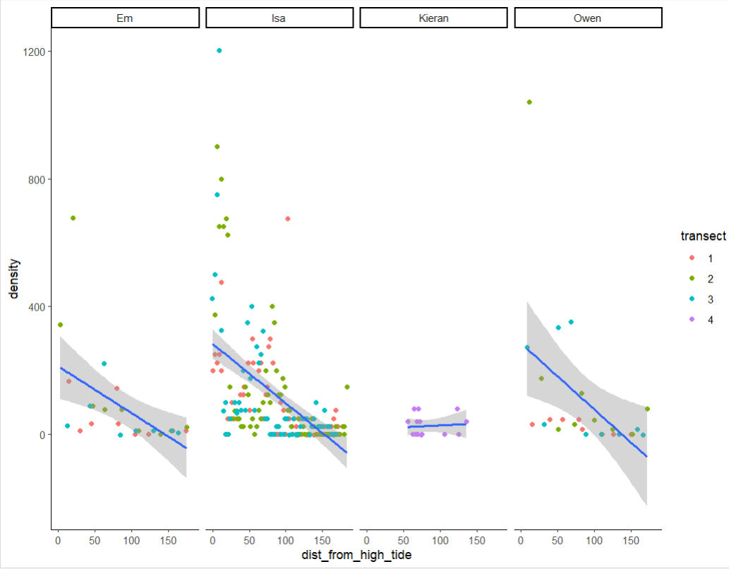

Slide 8
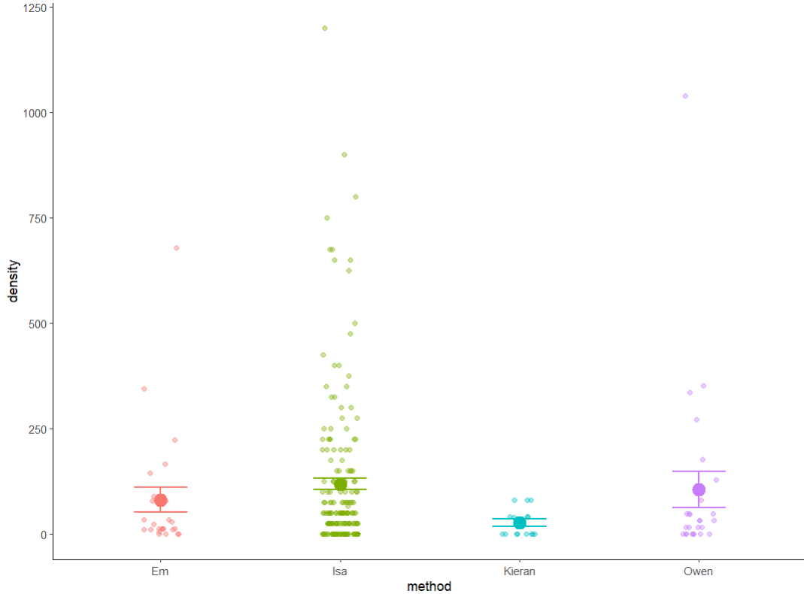

Slide 9
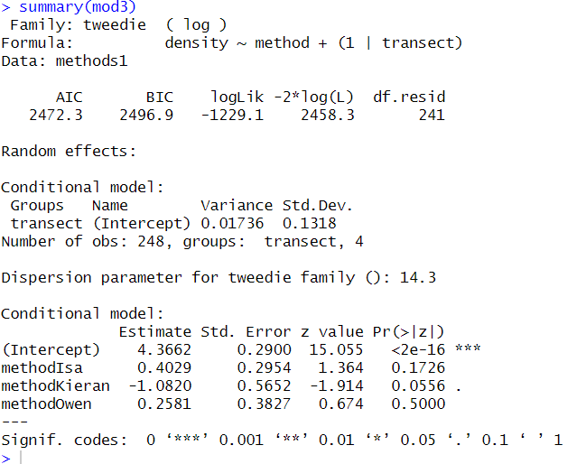

Slide 10
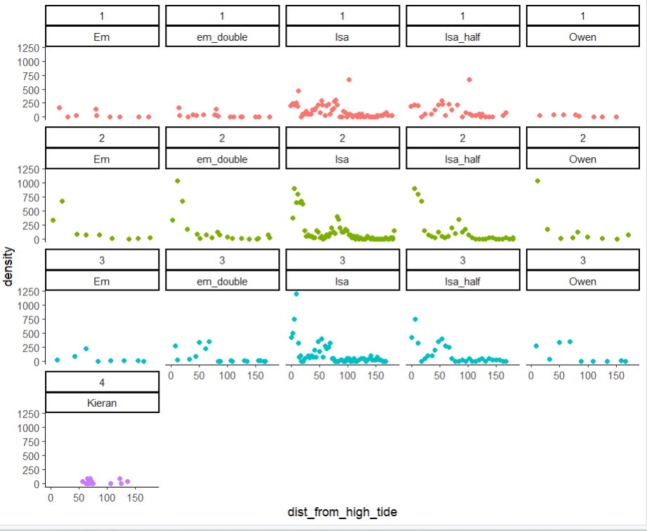

Slide 11
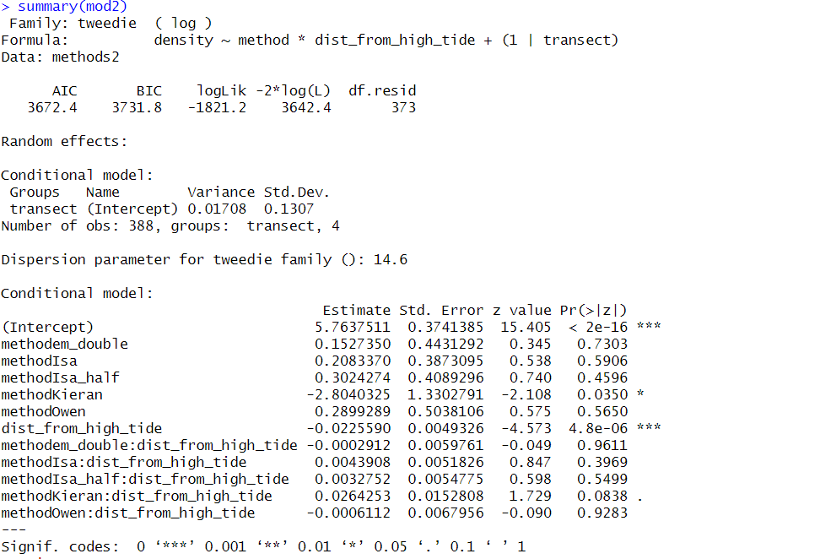

Slide 12
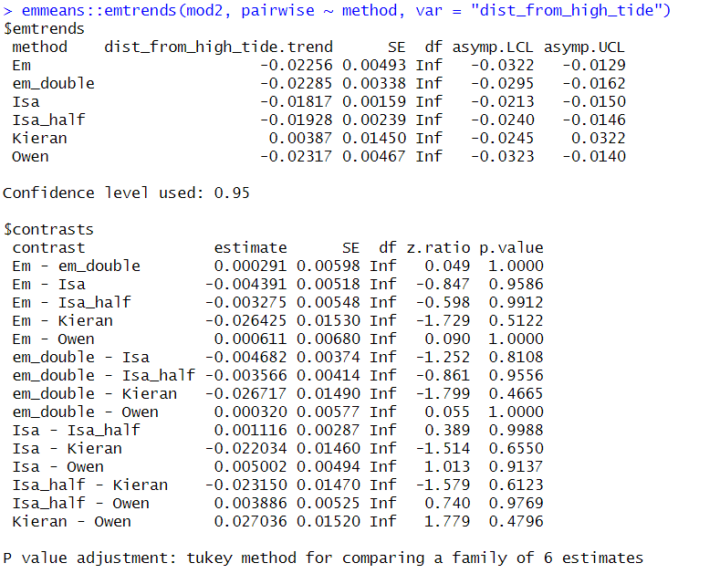

Slide 13
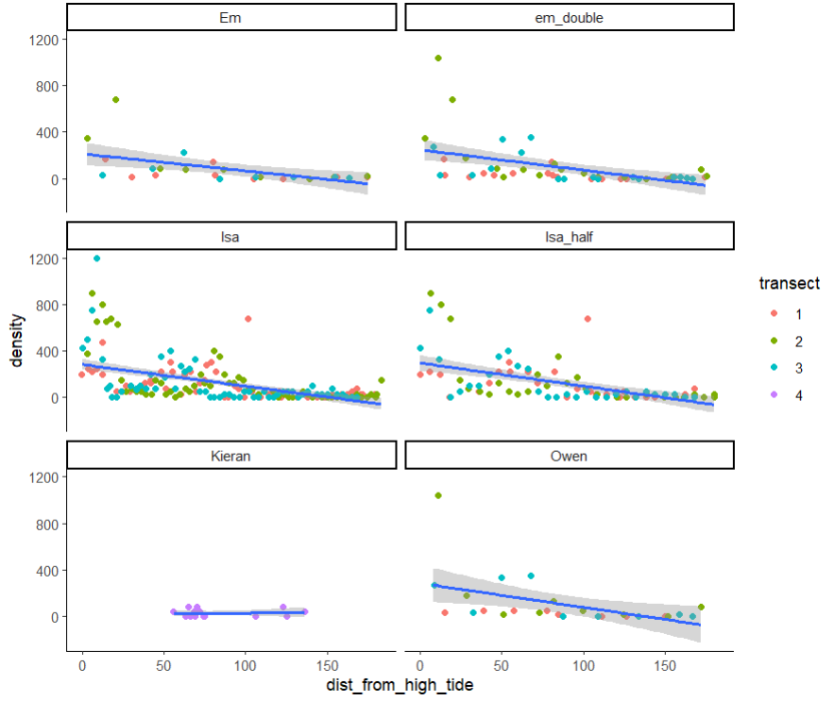

Slide 14
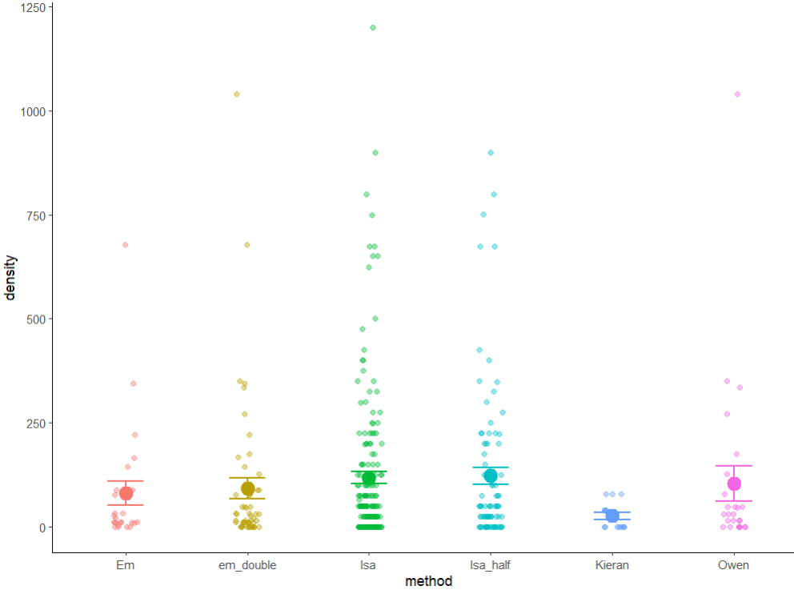

Slide 15
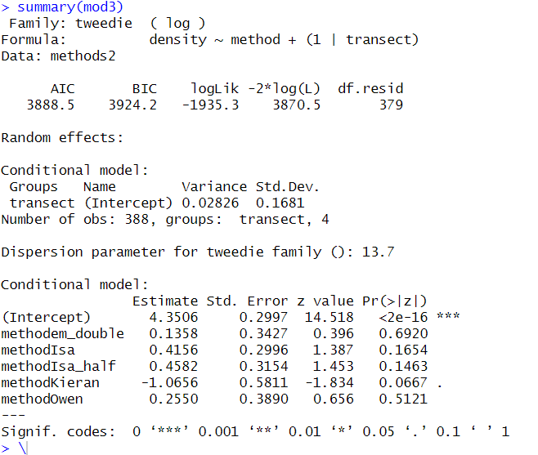

Slide 16
Discussion time
When comparing, do we want to compare at high tide line, overall density?
Seems like they are comparable?
Seems like not kierans
What to think about
Efficiency trade offs

Slide 17
Did we answer our questions
Are the methods comparable?
Which methods are we going to use to survey moving forward?

